Slide 1
Sunnybrook Neuroimaging Summer School 2025
Perfusion Module
Tutorial #2:
Multi-PLD Images and Generating an Arterial Transit Time (ATT) Map
Emma Pineau

Slide 2
Tutorial Overview
Refresher on Multiple Post Label Delay Arterial Spin Labeling
Step-by-step demonstration of multi PLD ASL analysis using command line tools from Oxford ASL
Full analysis walkthrough using the BASIL GUI from Oxford ASL

Slide 3
Part I: Theory Refresher

Slide 4
The Problem with Single PLD Data
PLD = Post Label Delay
Choosing PLD is a difficult task and poses a trade-off:
If the PLD is too short, labeled blood won’t have yet reached the capillary bed
Time for labeled blood to reach capillary bed is termed arterial transit time (ATT)
If the PLD is too long, signal will be lost due to T1 relaxation

Slide 5
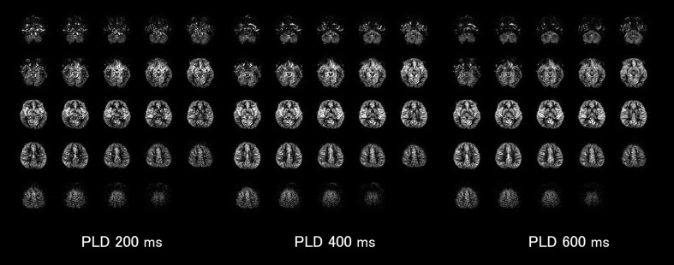
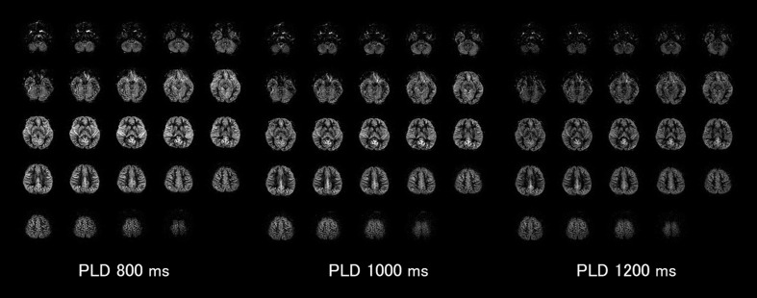
The Problem with Single PLD Data
Katajima & Uetani, Magn Res Med Sci, 2022

Slide 6
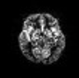

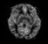
The Problem with Single PLD Data
Image has non-uniform SNR, high signal only in areas with low ATT like the thalamus
SNR is higher and more uniform across the entire image
SNR is reduced overall, but especially in areas with low ATT
PLD = 200ms
PLD = 600ms
PLD = 1000ms
Katajima & Uetani, Magn Res Med Sci, 2022

Slide 7
The Problem with Single PLD Data
PLD = Post Label Delay
Choosing PLD is a difficult task and poses a trade-off:
If the PLD is too short, labeled blood won’t have yet reached the capillary bed
Time for labeled blood to reach capillary bed is termed arterial transit time (ATT)
If the PLD is too long, some signal will be lost due to T1 relaxation
Different brain regions have different ATTs and thus different optimal PLD

Slide 8
Multi PLD Acquisition
Solution: obtaining a series of label and control images with multiple different PLDs to account for variations in ATT
Labeled Image
Labeled Image
Labeled Image
Labeled Image
Labeled Image
-
-
-
-
-
Control Image
Control Image
Control Image
Control Image
Control Image
=
=
=
=
=
Perfusion-Weighted Subtraction Image
Perfusion-Weighted Subtraction Image
Perfusion-Weighted Subtraction Image
Perfusion-Weighted Subtraction Image
Perfusion-Weighted Subtraction Image
PLD 1
PLD 2
PLD 3
PLD 4
PLD 5

Slide 9
How can we generate Arterial Transit Time (ATT) and Cerebral Blood Flow (CBF) Maps From Multi-PLD ASL ?
In single PLD:
CBF_{xyz} = f(T1, M_{0,} ATT,…)
All independent variables are known a priori from other measurement or assumed

Slide 10
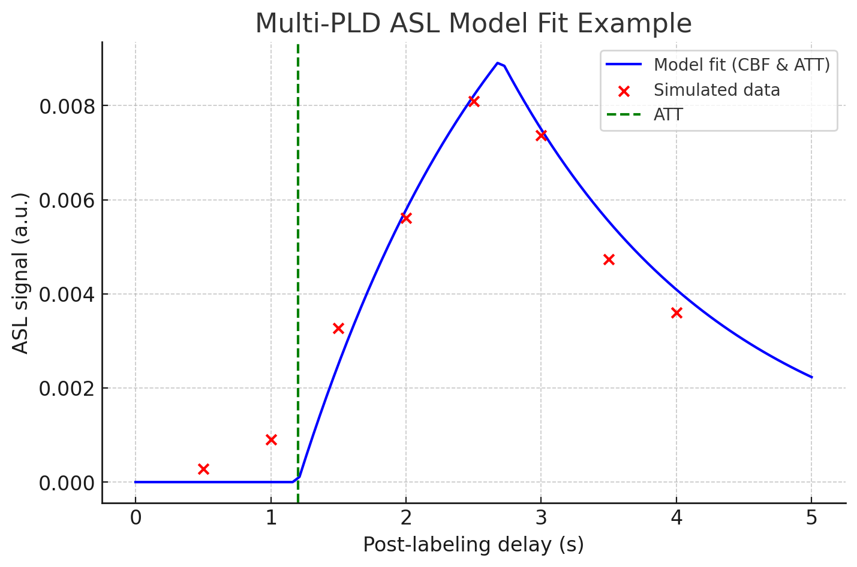
How can we generate Arterial Transit Time (ATT) and Cerebral Blood Flow (CBF) Maps From Multi-PLD ASL ?
In single PLD:
CBF_{xyz} = f(T1, M_{0,} ATT,…)
All independent variables are known a priori from other measurement or assumed
In Multi PLD:
CBF_{xyz} = f(T1, M_{0,} ATT,…)

Slide 11
Part II: How to Perform the Analysis
First, we will go step-by-step and use the command line tools from Oxford ASL!

Slide 12
Step 0: Pre-Analysis Checklist
Raw ASL data & dataset of Label-Control Pairs
2. Calibration image
Such as a M₀ map that is proton-density weighted
3. Know the number of tag/control pairs and their associated PLDs
4. Know essential imaging parameters (TR, resolution etc.)
5. High resolution T1 structural scan
Use to check for artifacts and to obtain high resolution mask for ROI analysis
Notes:
2. PWD calibration image needed to estimate equilibrium magnetization M0 – to convert signal in arbitrary ASL units to absolute CBF. Needs to match the resolution and FOV of ASL data so we can assume that the same tissue properties are represented in each voxel.
3. Higher resolution and contrast makes tools like BET ( brain extraction in FSL) that much more accuate

Slide 13
Step 1: Look at the Raw ASL Data
This is a 3d+time dataset
It has shape [x,y,z,t]
Each time point alternates whether it is a label or control image
The PLDs are listed in the file name
Looking at raw data is always best practice!
Are there any artifacts?
Do you have the number of volumes you expect?

Slide 14
Exercise:
Use fslhd filename.nii.gz to look at the image header:
1. What is the shape of the ASL image matrix?
2. How many volumes are in this dataset? What does that correspond to in terms of label/control image pairs?

Slide 15
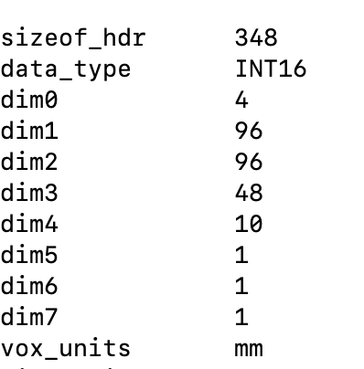
Exercise:
Shape is [96,96,48,10]
There are 10 timepoints so 5 sets of label and control image pairs

Slide 16
Exercise:
Use cat input.json to view more parameters about the image acquisition. What was the repetition time?
The volumes were acquired in alternating control and label images, starting with a label. Which image volume contains the control image for PLD = 2.1s?
Use fsleyes to open the T1-weighted, structural image. Do you see any artifacts or abnormal features?

Slide 17
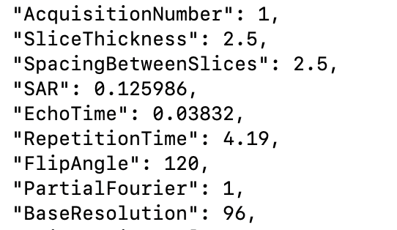
Exercise:
TR in seconds
2. 2.1s is the 3rd PLD so the 6th volume is the corresponding PLD.

Slide 18
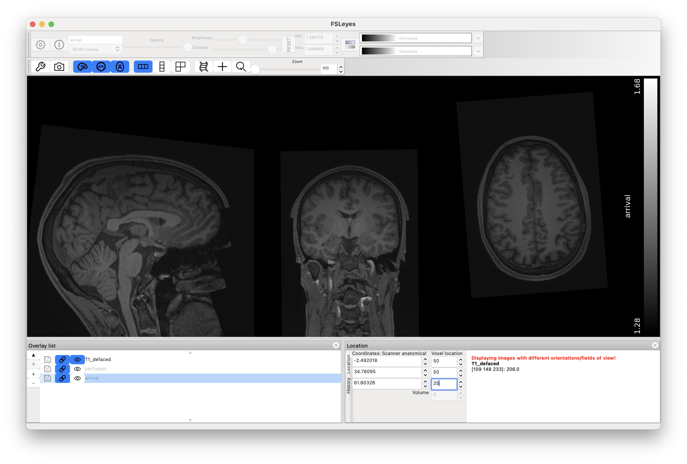
Exercise:

Slide 19
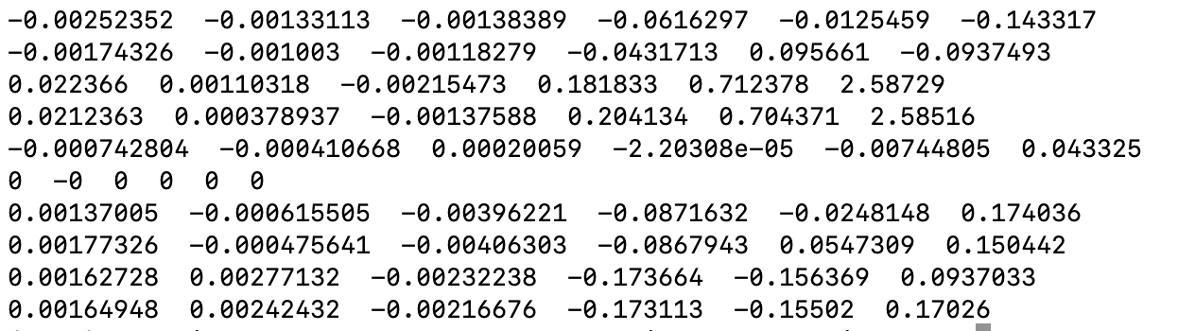
Step 2: Motion Correction
**optional but good practice when your dataset has a time axis**
command: mcflirt –in input_file.nii.gz –out output_file –plots
output:
Translation
Rotation
x
y
z
pitch
roll
yaw
Volumes
reference volume

Slide 20
Exercise:
Run mcflirt to motion correct the label/control pair image series:
Which volume has the greatest z translation from the reference?
Which axs has the greatest rotation on average across the volumes?

Slide 21
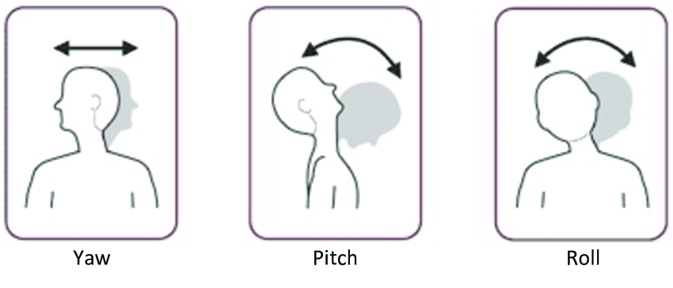
Exercise:
The greatest rotation is in the yaw direction
Slice 9 has the greatest z-translation from the reference
Alghowinem, 2015

Slide 22
Step 3: Separate Control and Label Images
1. Extract Individual Volumes
command: fslsplit input_file.nii.gz vol_
output: vol_001.nii.gz …..
2. Group control and label images
command: fslmerge –t labels.nii.gz vol_0000.nii.gz vol_0002.nii.gz …
fslmerge –t controls.nii.gz vol_0001.nii.gz vol_0003.nii.gz …

Slide 23
Step 4: Subtract Control from Labeled Images
command:
fslmaths controls.nii.gz -sub labels.nii.gz subtraction_image.nii.gz
output: image matrix contraining 5 subtraction images!

Slide 24
Exercise:
1. Using command line: extract control and label images
2. Using command line: compute the subtraction images
3. Look at the subtraction images. Do you notice certain ROIs that appear to have different contrast at different PLDs?

Slide 25
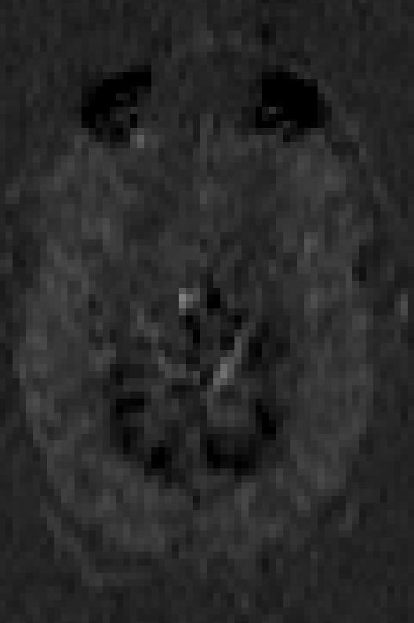
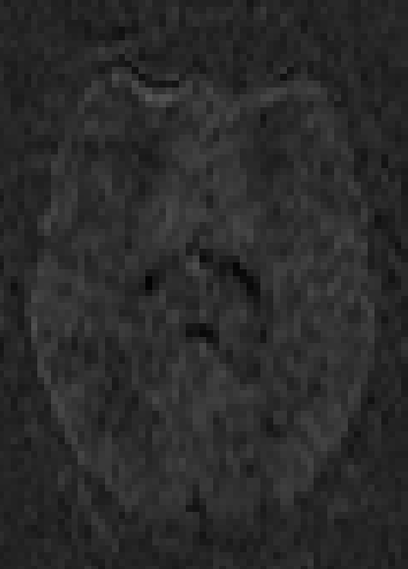
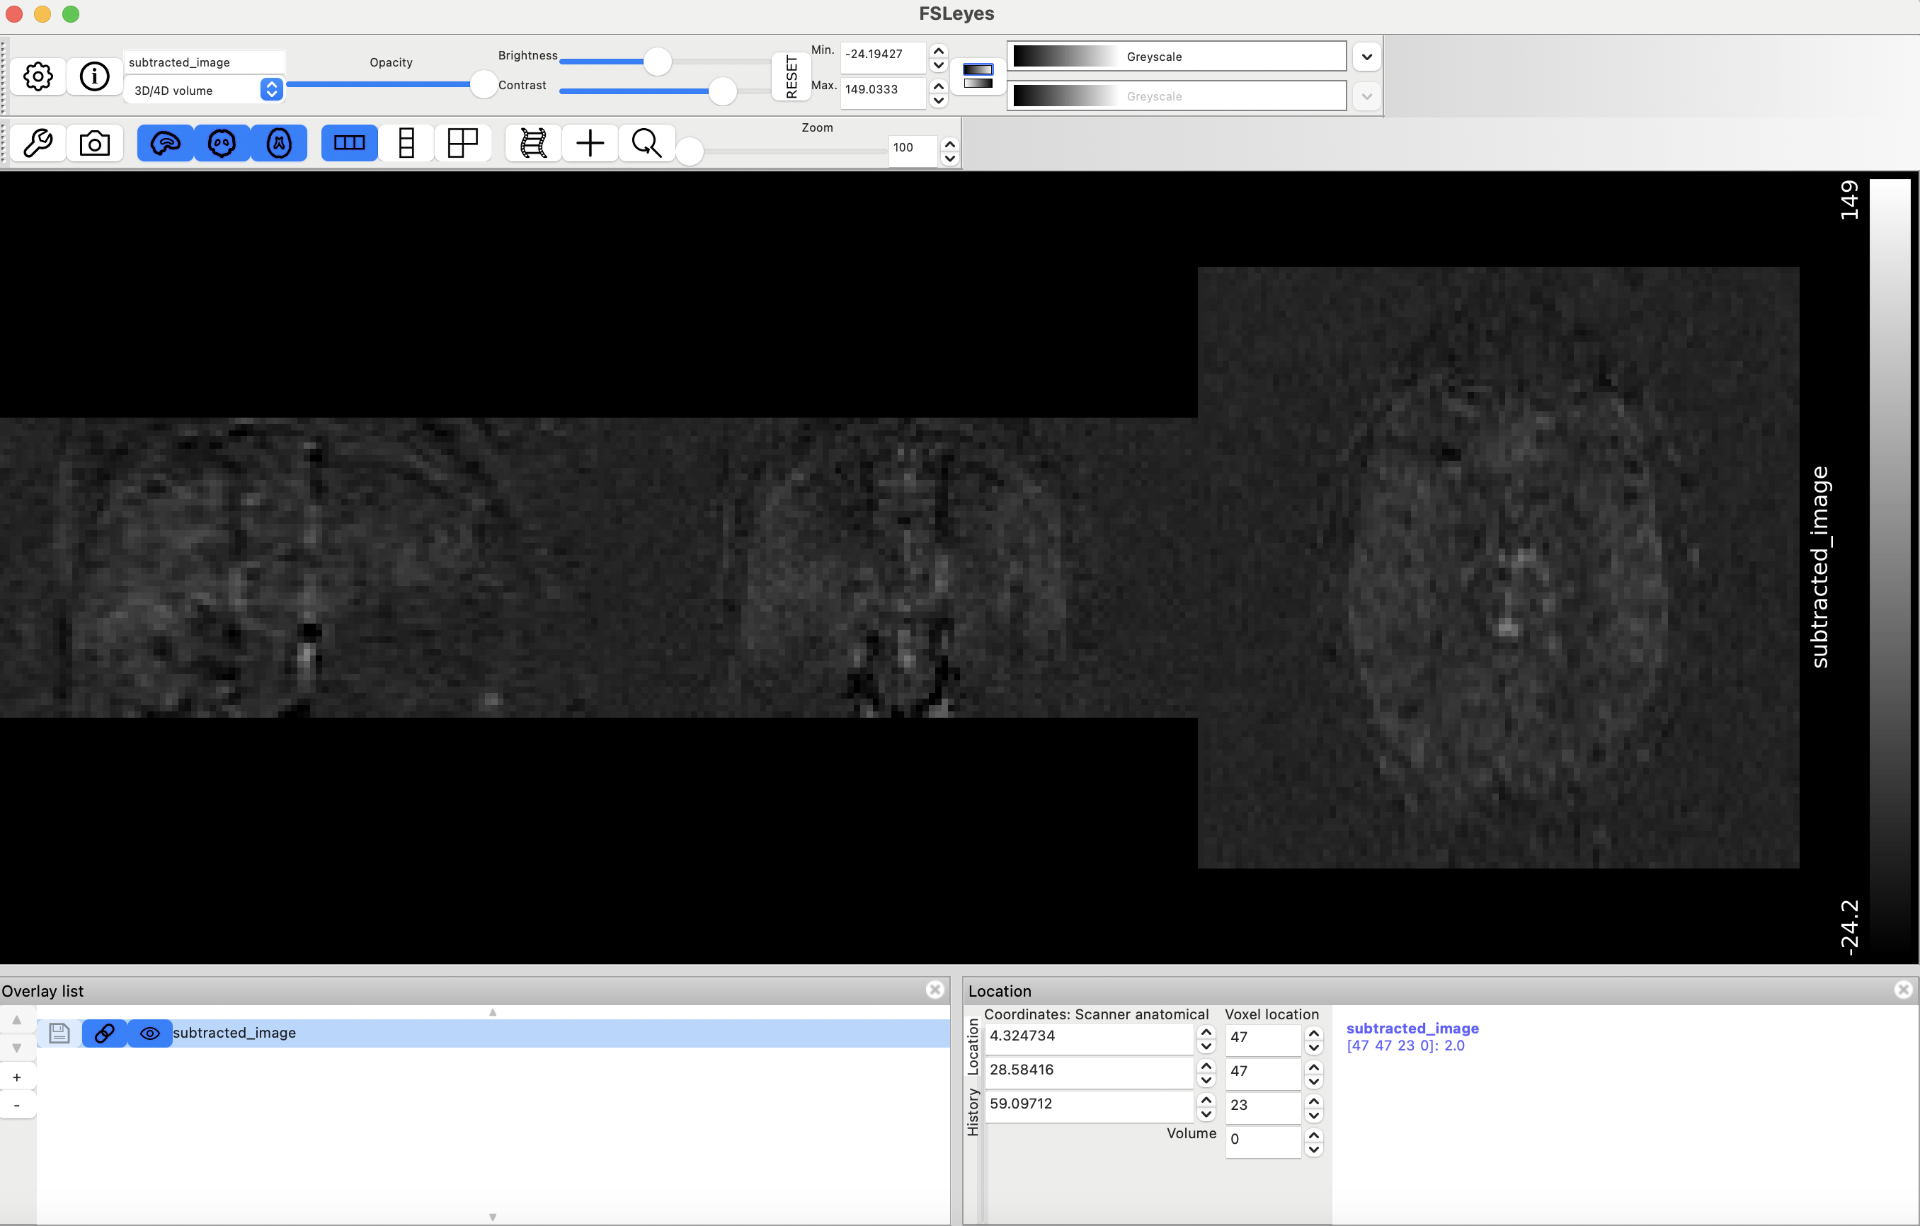
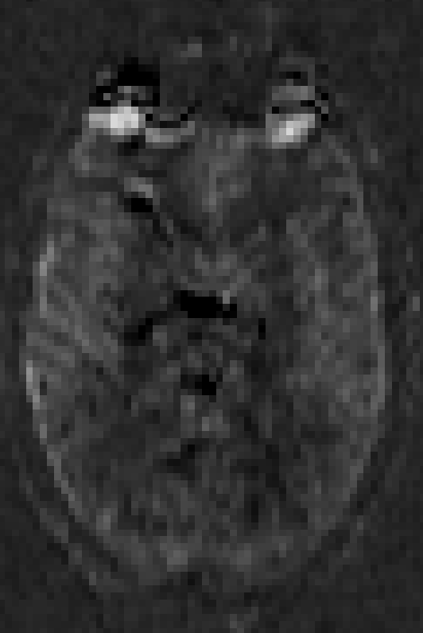
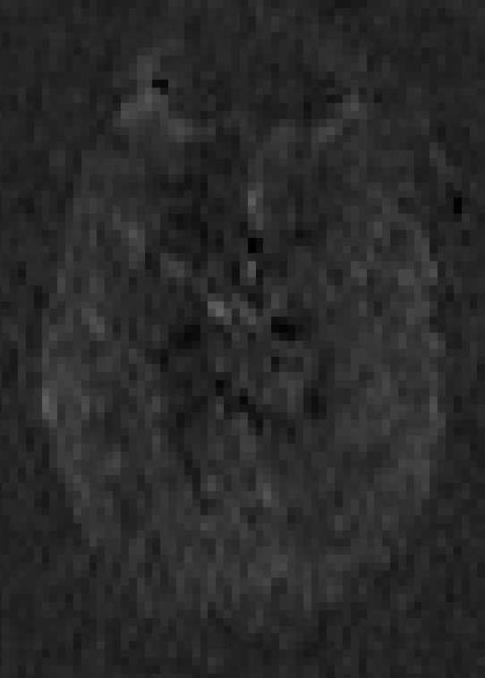
Exercise:
Subtraction Image 2
PLD = 600ms
Subtraction Image 3
PLD = 2100ms
Subtraction Image 1
PLD = 1800ms
Subtraction Image 4
PLD = 1200ms
Subtraction Image 5
PLD = 200ms

Slide 26
Step 5: Generate Brain Mask
bet T1_defaced.nii.gz T1w_brain.nii.gz
flirt -in T1w_brain.nii.gz –ref subtraction_image .nii.gz –T1w2asl.nii.gz –omat T1w2asl.mat
flirt -in T1w_brain_mask.nii.gz -ref asl.nii.gz \
-out T1w_brain_mask_in_asl.nii.gz \
-applyxfm -init T1w2asl.mat -interp nearestneighbour
fslmaths T1w_brain_mask_in_asl.nii.gz –bin T1w_brain_mask_in_asl_bin.nii.gz

Slide 27
Exercise:
1. Generate a brain mask using the previous commands
2. Open fsleyes and overlay the subtraction image series over the mask. How is the alignment?

Slide 28
Step 5: Generate Brain Mask
bet T1_defaced.nii.gz T1w_brain.nii.gz
flirt -in T1w_brain.nii.gz –ref subtraction_image .nii.gz –T1w2asl.nii.gz –omat T1w2asl.mat
flirt -in T1w_brain_mask.nii.gz -ref asl.nii.gz \
-out T1w_brain_mask_in_asl.nii.gz \
-applyxfm -init T1w2asl.mat -interp nearestneighbour
fslmaths T1w_brain_mask_in_asl.nii.gz –bin T1w_brain_mask_in_asl_bin.nii.gz

Slide 29
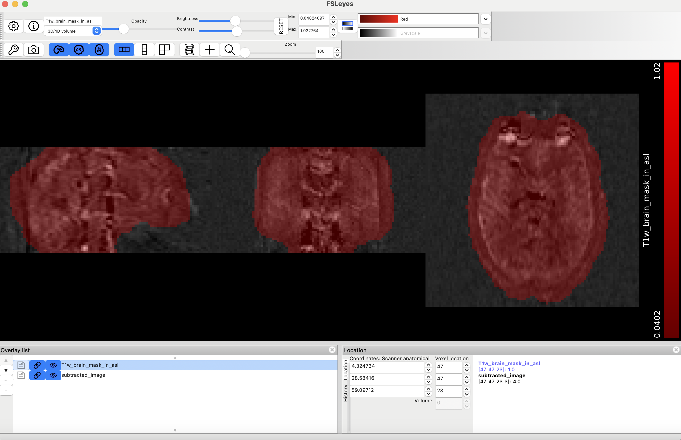
Exercise:

Slide 30
Step 5b: Process Structural Image
To be even more thorough (though it takes much longer to run!), can using fsl_anat to process structural image prior to using it in the model
Command: fsl_anat –i T1_defaced.nii.gz
Image reorientation to standard space
Image cropping
Bias Correction
Registration (using flirt)
Brain extraction (using bet)
Tissue segmentation (using fast)
Subcortical segmentation (using first)

Slide 31
Step 6: Bayesian Modelling to Estimate CBF and ATT
Input Image
oxford_asl -i perfusion_weighted.nii.gz \
-o command_output \
-c PDw_TR4190ms.nii.gz \
--casl \
--iaf=diff \
--bolus=1.6 \
--tr=4.19 \
--tis=3.4,2.2,3.7,2.8,1.8 \
--fslanat=T1_defaced.anat \
Output Directory
Calibration Image
Acquisition Mode
Specifies that the input contains difference (subtracted) images
Length of the Labeling Pulse
Repetition Time
Labeling Pulse + PLDs *
Directory which contains the processed structural image

Slide 32
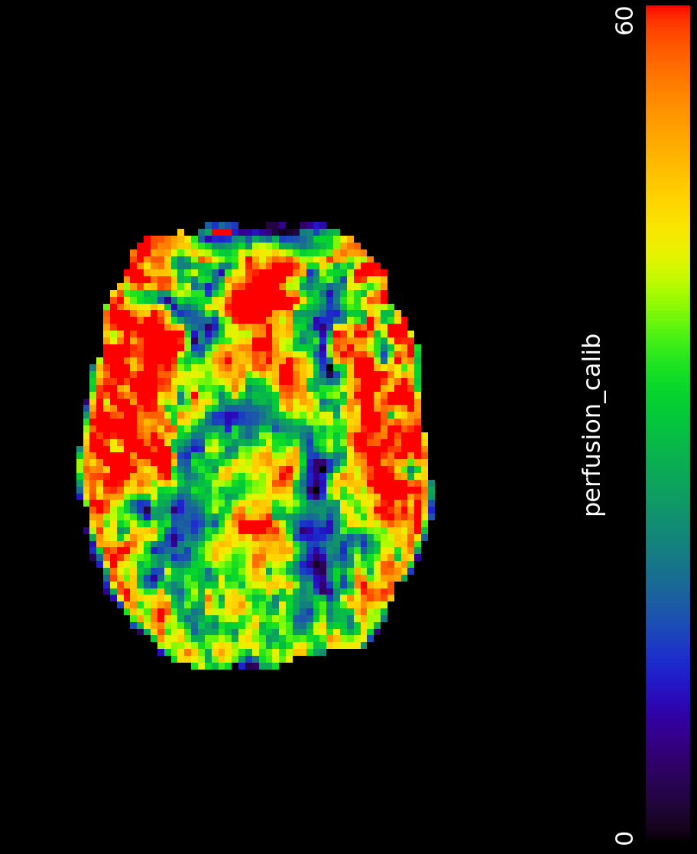
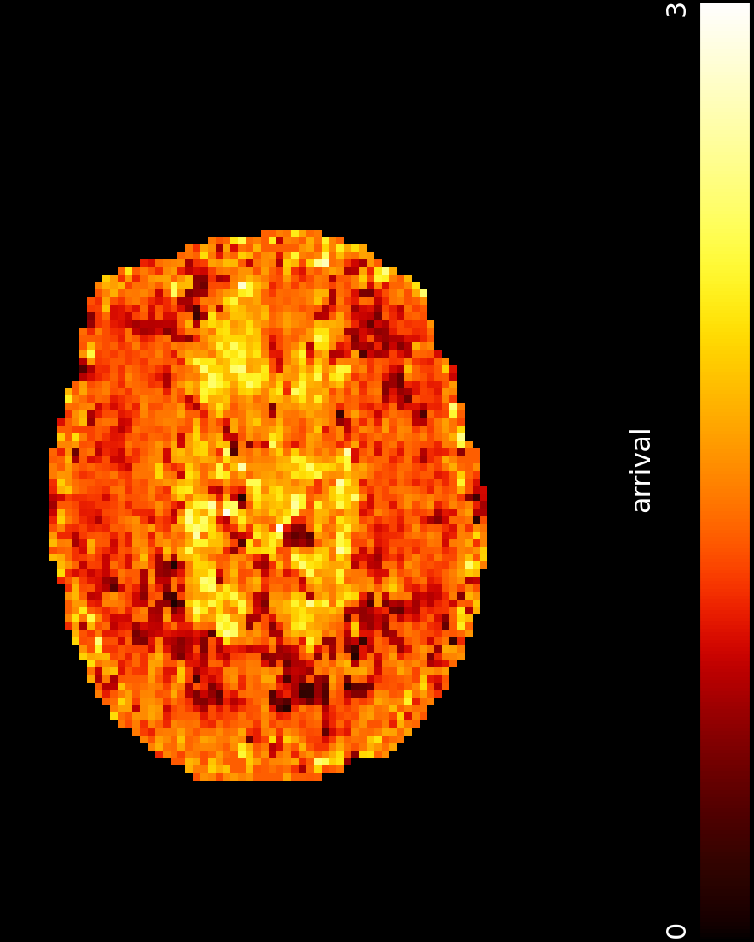
CBF and ATT Maps
CBF
(mL/100g/min)
ATT
(seconds)
Called native_space/
perfusion_calib.nii.gz in output
Called native_space/ arrival.nii.gz in output

Slide 33
To Get Quantification
Let’s look at the estimated values of CBF and ATT at a particular voxel (i.e., x, y, z = 57, 42, 23)
fslroi perfusion_calib.nii.gz voxel_cbf.nii.gz 57 1 42 1 23 1
fslstats voxel_cbf.nii.gz –M
fslroi arrival.nii.gz voxel_att.nii.gz 57 1 42 1 23 1
fslstats voxel_att.nii.gz –M

Slide 34
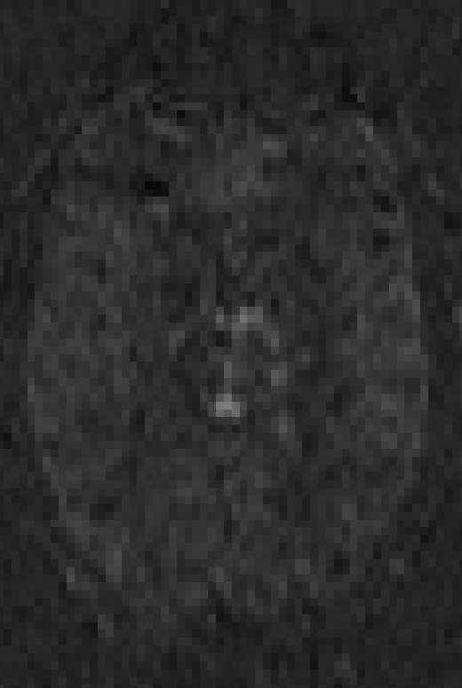
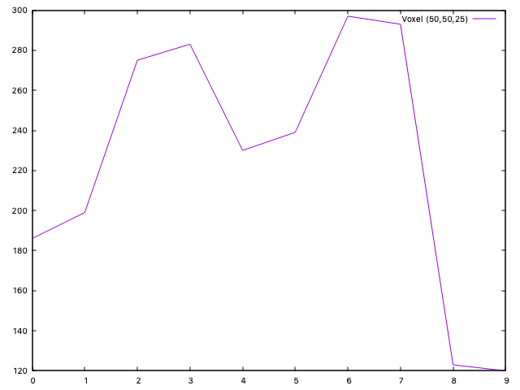
Interpreting How CBF and ATT Interplay
Subtraction images in order of ascending PLD
Subtraction image looks dark if ATT is long and PLD is too short
High CBF areas often match bright subtraction signal only if ATT is short enough relative to PLD
Notes:
Any negative CBF estimations means that the control label has higher signal than the label (likely due to the noise floor or parameter uncertainty).

Slide 35
Part III: Full Walkthrough
Using the BASIL GUI from Oxford ASL!

Slide 36
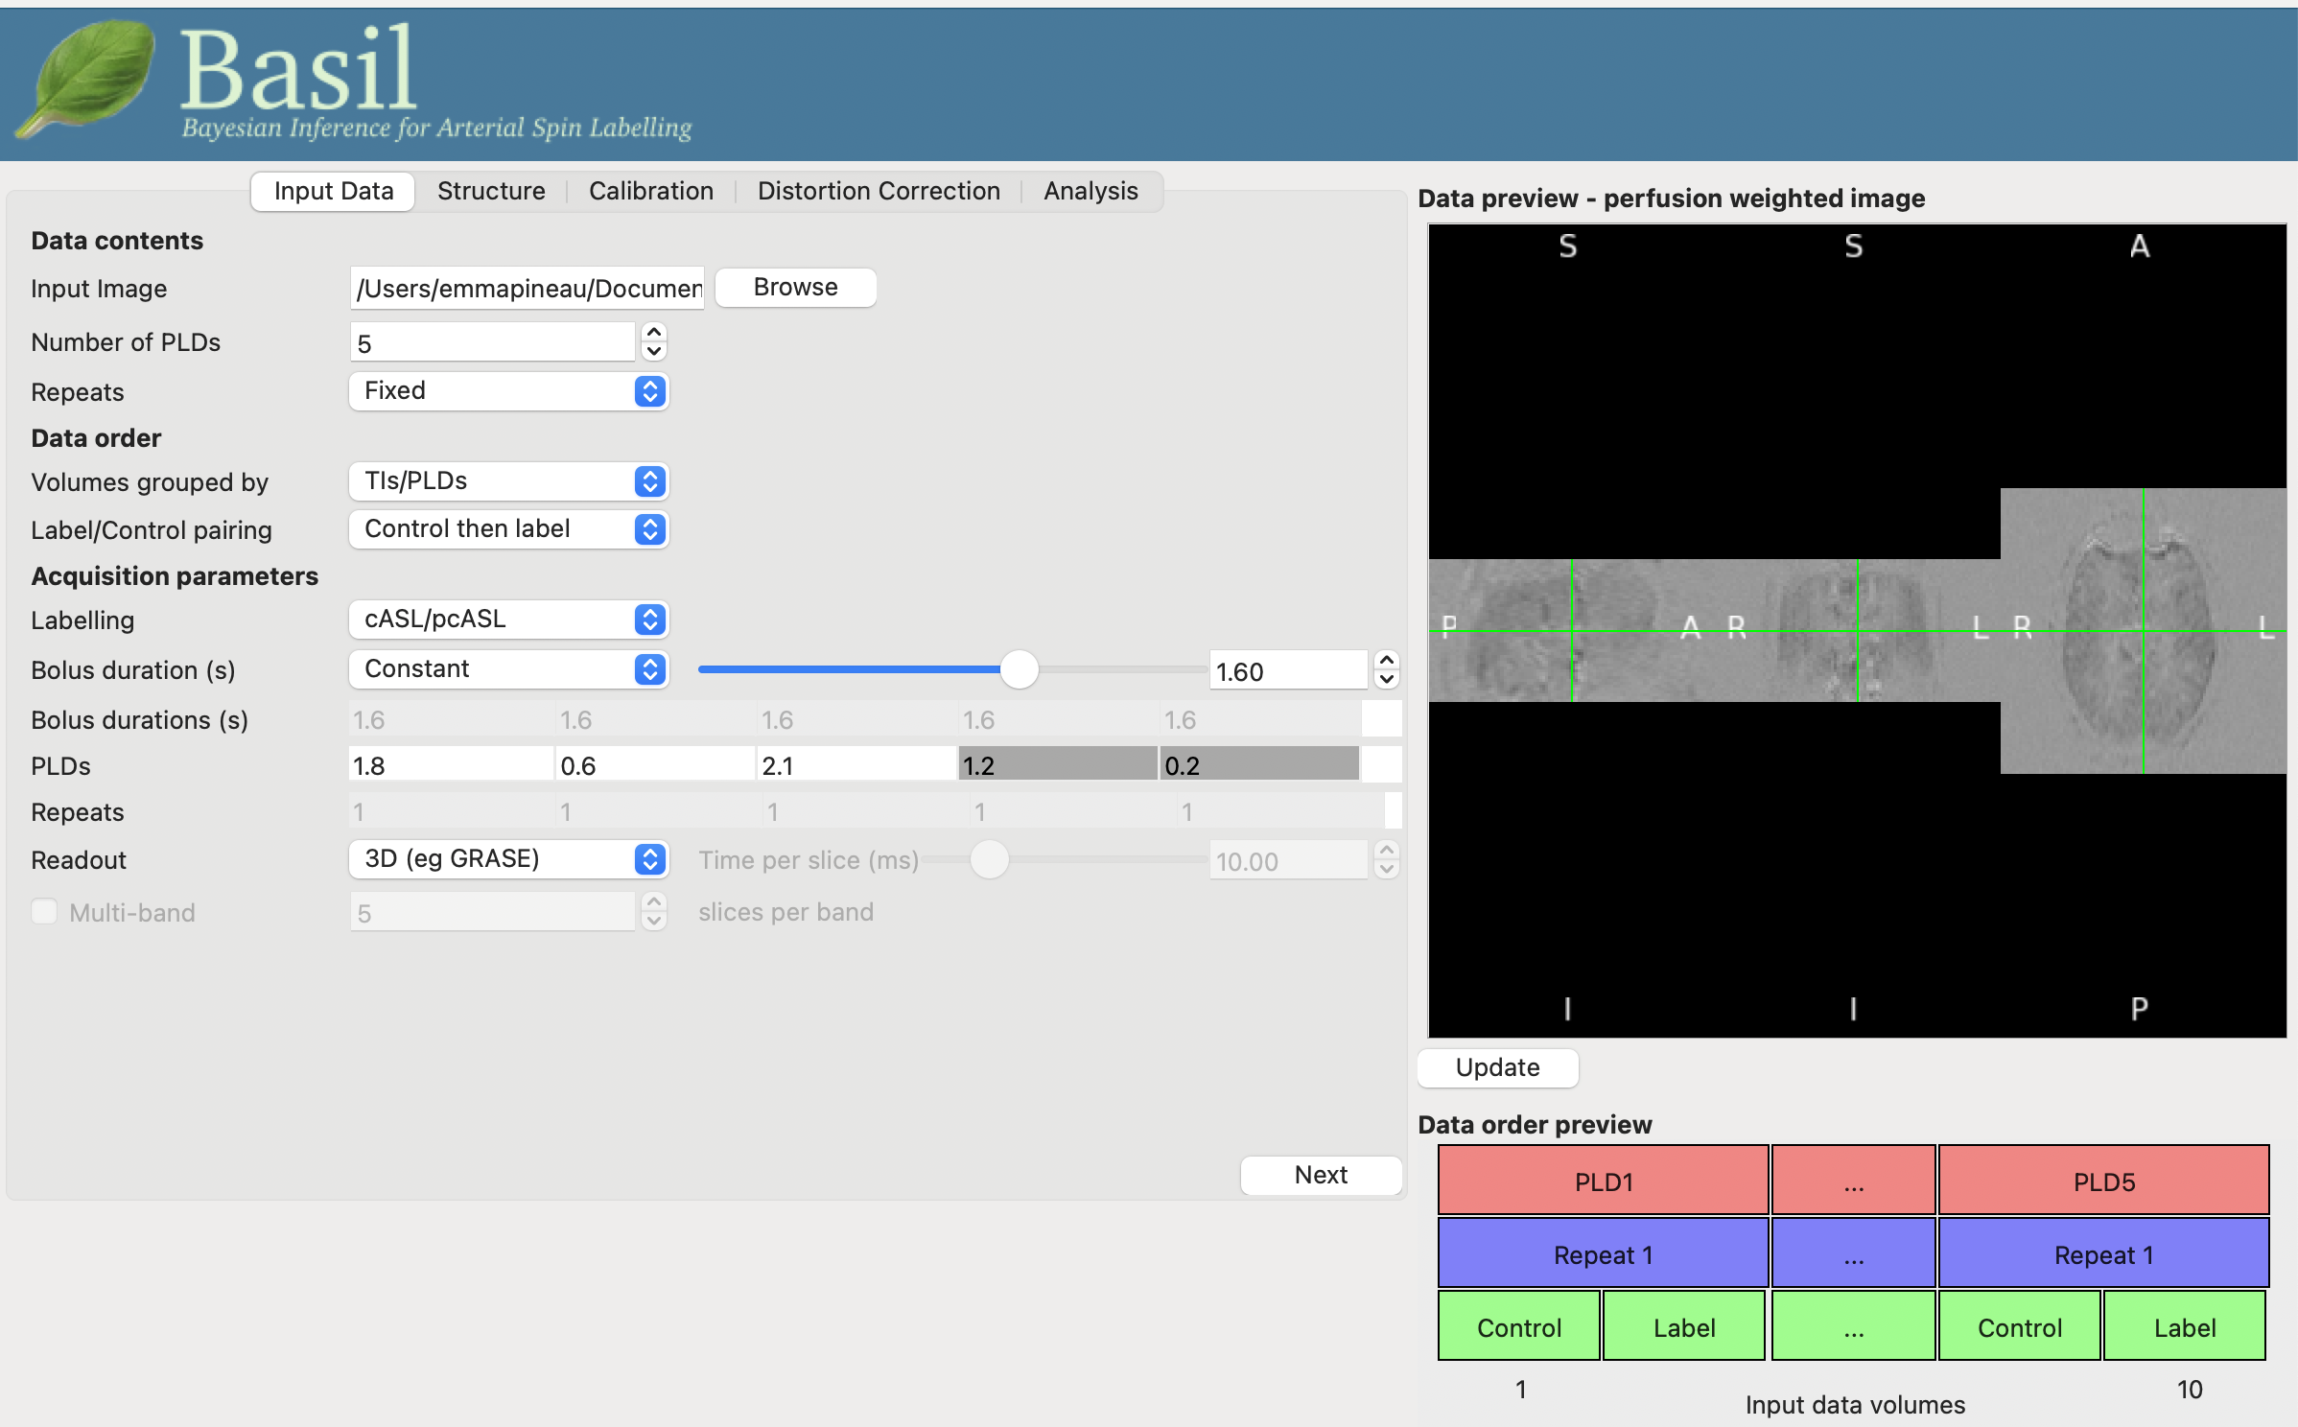
Input Data
Open gui with command:
asl_gui

Slide 37
Input Data
Specify input dataset and some acquisition parameters

Slide 38
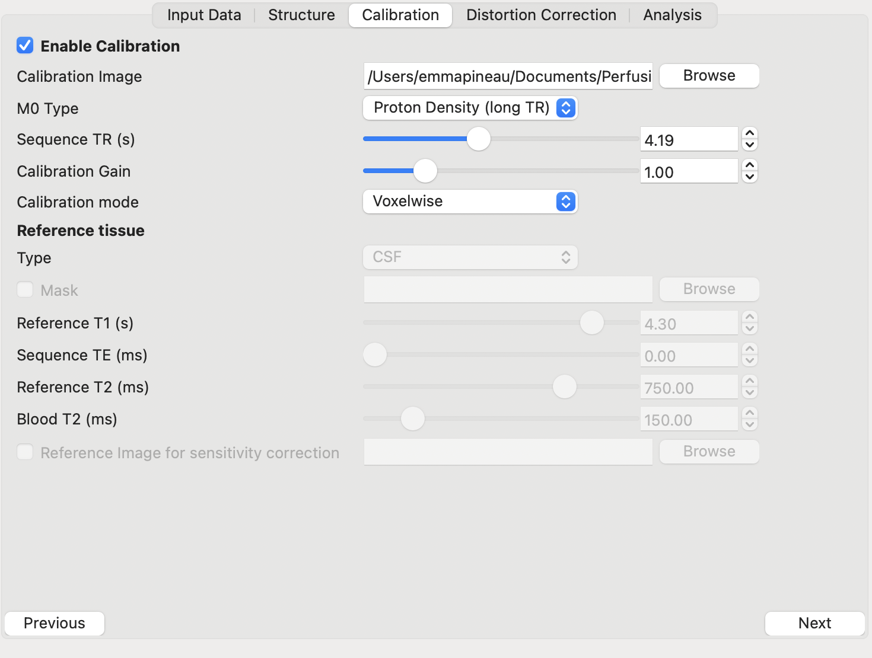
Calibration
Specify calibration image and voxelwise calculation

Slide 39
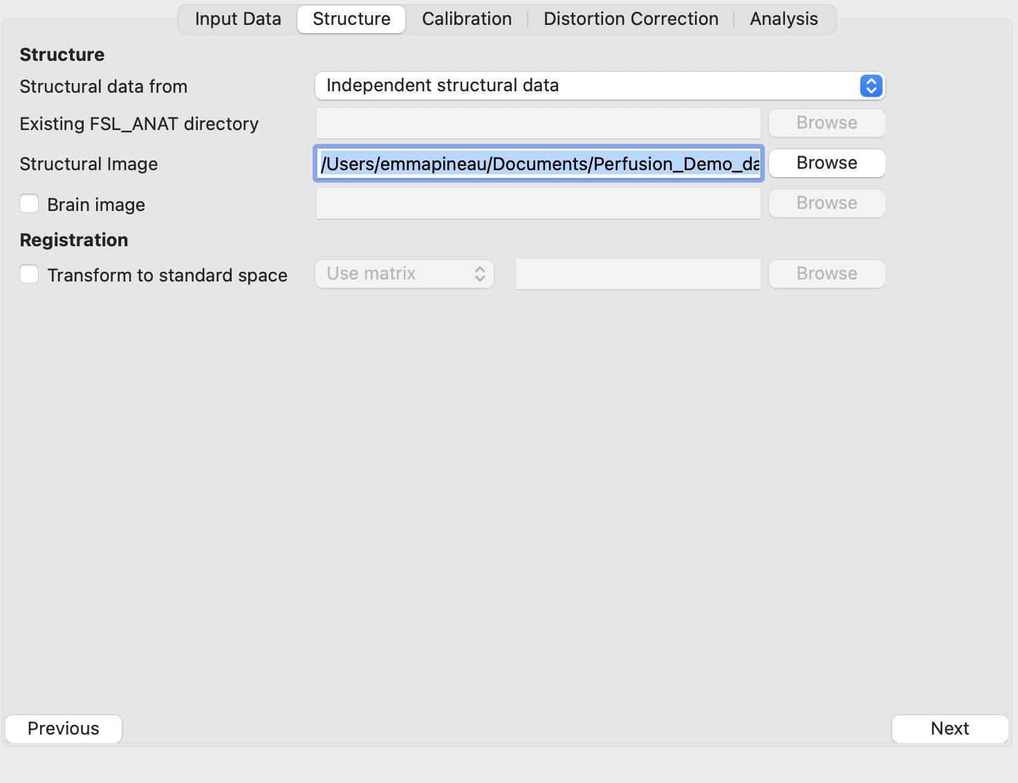
Structural Reference
Structural image used to mask brain

Slide 40
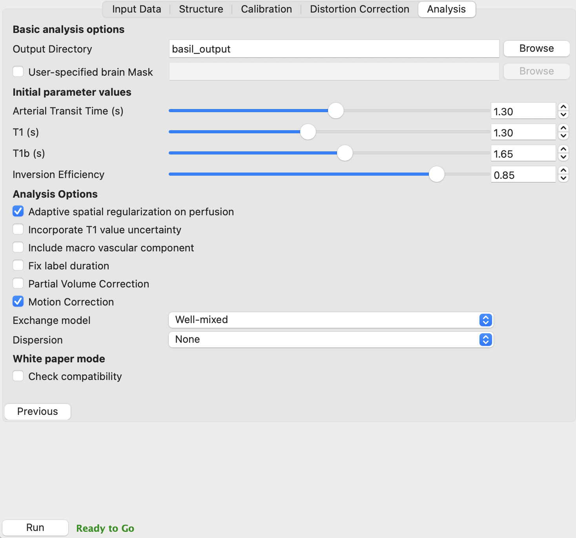
Analysis Parameters
Choose some analysis parameters
1. Initial guesses for ATT, T1, inversion efficiency
2. Spatial smoothing
3. Motion correction
Notes:
-Well-mixed means the model assumes that once label enters the tissue compartment, it is instantaneously and uniformly mixed with the tissue water, and the signal from that compartment is homogeneous
-None means BASIL assumes the bolus remains “square” in shape — it arrives after a single ATT (arterial transit time) and stays intact until it decays via T1 relaxation which is true in healthy tissue with short ATT

Slide 41
CBF and ATT Maps
CBF
(mL/100g/min)
ATT
(seconds)
Called native_space/
perfusion_calib.nii.gz in output
Called native_space/
arrival.nii.gz in output

Slide 42
References and Further Reading
Command Line User Guide:
https://asl-docs.readthedocs.io/en/latest/oxford_asl_userguide.html
GUI User Guide:
https://asl-docs.readthedocs.io/en/latest/gui_userguide.html
Buxton Papers:
https://doi.org/10.1002/mrm.1910400308
https://doi.org/10.1002/jmri.20462

